Slide 1
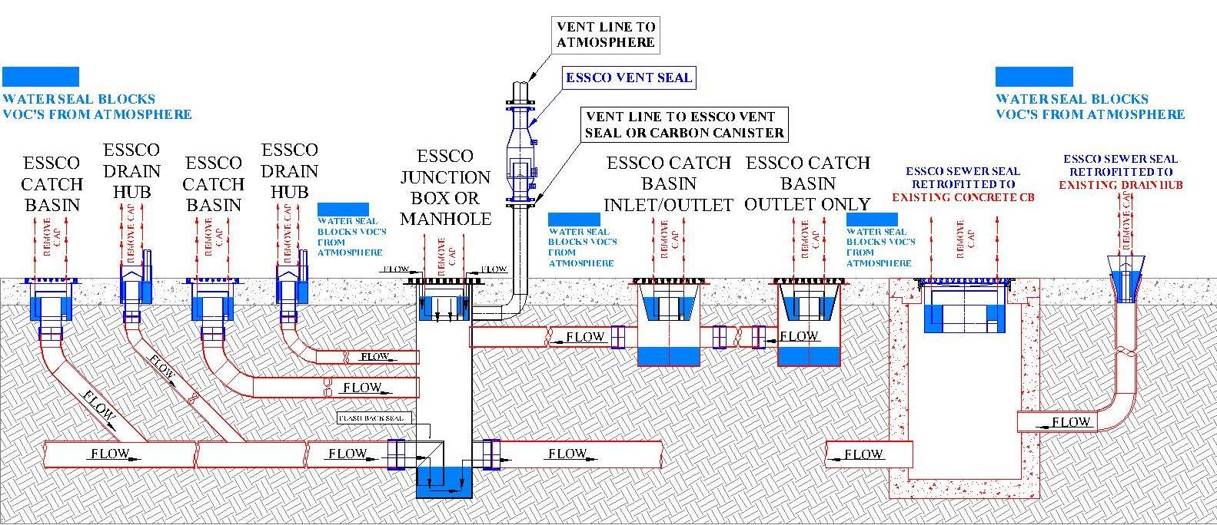
EPA COMPLIANCE FOR QQQ, B-1, HON & NSPS
STORM WATER PHASE II REGULATIONS
API RP 500 TYPE 1 OPEN DRAIN
CATCH BASINS, DRAIN HUBS, SEWER SEALS & MANHOLES FOR REFINING, PETROCHEMICAL,
GAS PROCESSING, PULP & PAPER AND MUNICIPAL STORM WATER APPLICATIONS
P.O. BOX 77077
BATON ROUGE, LA 70879
(225) 753-1505
E-MAIL: Info@sewerseals.com
WEB: www.sewerseals.com
ESSCO CATCH BASINS CAN BE DESIGNED FOR
ANY FLOW RATE & ANY SIZE OR TYPE LINE
ESSCO PRODUCTS ARE PROTECTED BY US &
INTERNATIONAL PATENTS AND/OR PATENTS PENDING

Slide 2
EPA COMPLIANCE DEFINED IN SIMPLE TERMS
EPA COMPLIANCE FOR QQQ, B-1, HON AND NSPS CAN BE DEFINED SIMPLY AS ANY OPENING SUCH AS A CATCH BASIN OR DRAIN HUB CONNECTED TO ANY SEWER SYSTEM THAT CURRENTLY CONTAINS ON CAN POSSIBLY CONTAIN ANY HYDROCARBONS (VOC’S) ON THE LIST OF THE EPA’S LIST OF CONTROLLED VOC’S MUST HAVE ENVIRONMENTAL CONTROLS IN PLACE TO PREVENT ANY OF THE CONTROLLED VOC’S FROM ESCAPING TO THE ATMOSPHERE. WATER SEALS ARE AN APPROVED METHOD OF CONTROL.

Slide 3
ESSCO CATCH BASINS, AREA DRAINS & SEWER SEALS
MEET EPA COMPLIANCE REQUIREMENTS FOR QQQ, B-1, NSPS & HON
MEET REQUIREMENTS FOR API STANDARD API RP 500 TYPE 1 OPEN DRAIN
MEET EPA COMPLIANCE REQUIREMENTS FOR STORMWATER PHASE II REGULATIONS
PROVIDES BARRIER TO PREVENT FIRE FLASHBACK BETWEEN CATCH BASINS
WORKS AS AN OIL/WATER SEPARATOR
WORKS AS A SOLIDS SEPARATOR
PREVENT SOLIDS FROM PLUGGING UNDERGROUND LINES.
PREVENTS SEWER EXPLOSIONS IN PROCESS AND OILY WATER SEWERS WHEN PROPERLY MAINTAINED
CONNECT TO ANY TYPE LINE – CARBON STEEL, CAST IRON, DUCTILE IRON AND PLASTIC WITH A STRAUB COUPLING

Slide 5
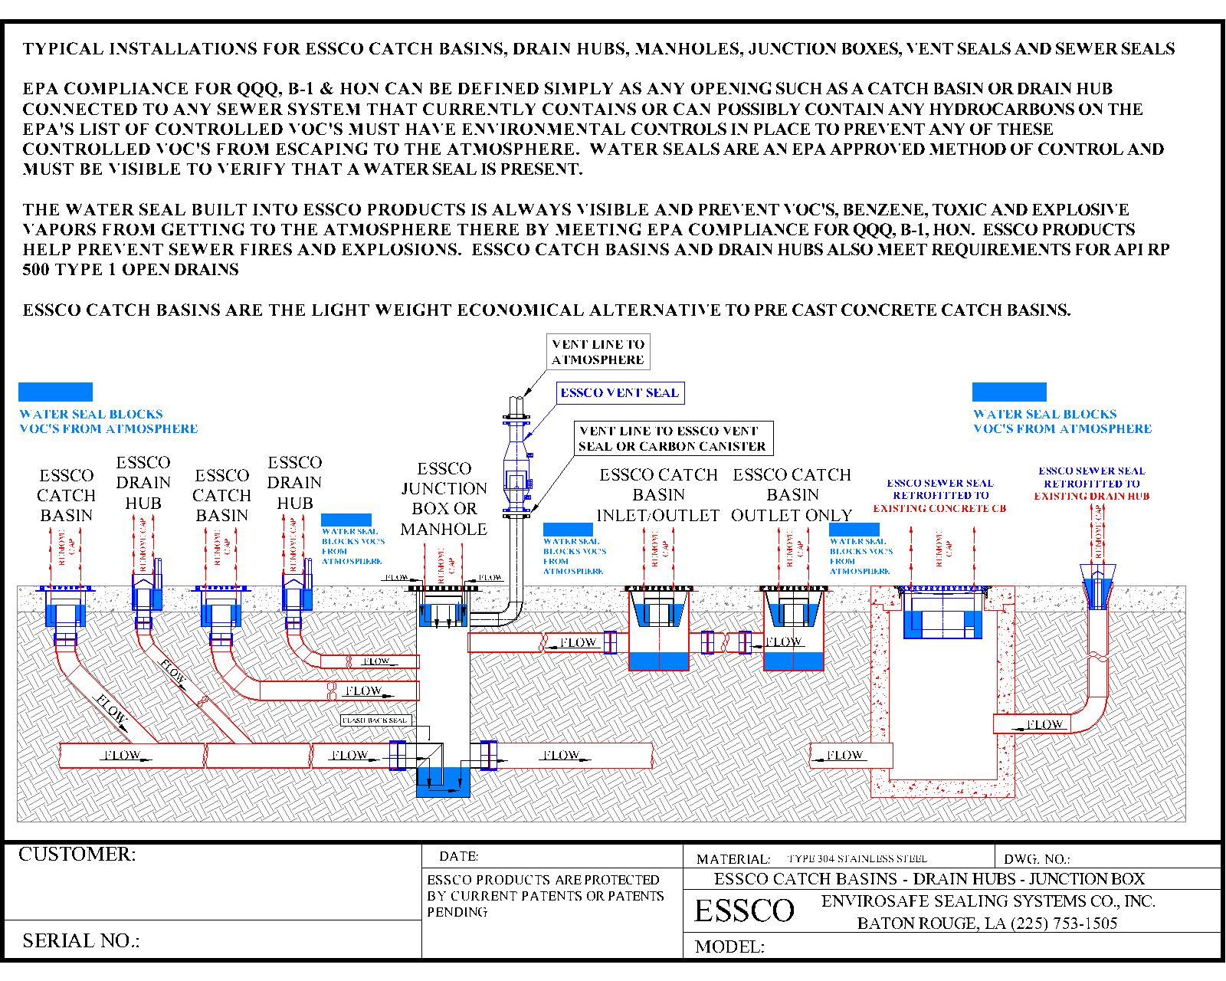

Slide 6
DESIGN ESSCO CATCH BASINS FOR NEW APPLICATIONS OR REPLACEMENT OF EXISTING OR DAMAGED CATCH BASINS NOT IN COMPLIANCE WITH EPA REGULATIONS FOR QQQ, B-1, HON & FOR API STANDARD API RP 500 TYPE 1 OPEN DRAIN

Slide 7
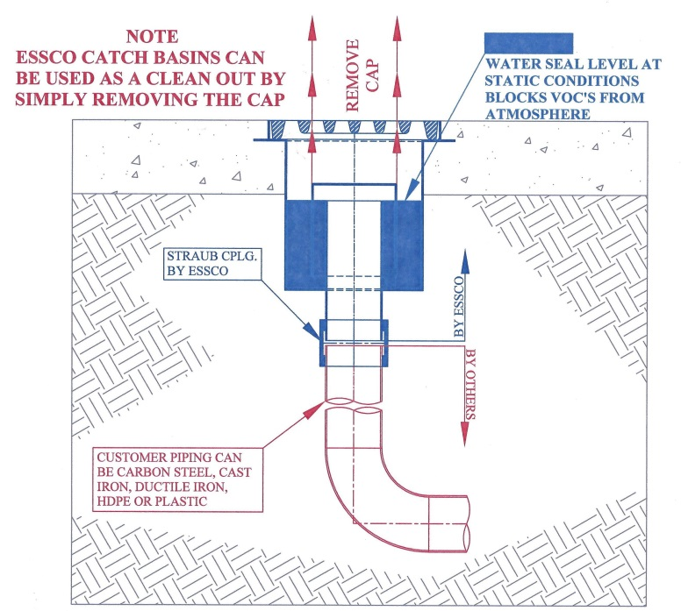
ESSCO CATCH BASIN DESIGN VS TYPICAL DRAIN HUB DESIGN
The ESSCO QQQ, B-1, HON & NSPS Compliant Catch Basin shown below by design collects all surface drainage, holds a water seal and works like a solids separator and collects the majority of any debris such as sand, dirt, gravel, etc. that washes into the drain preventing plugging of the underground lines & reductions in flow.
Safety is the most important benefit of the ESSCO Catch Basin design. When any hydrocarbons collect on the seal, simply remove the grate, remove the cap and flush with water. Hydrocarbons are flushed to the underground system. Replace the cap and a hot work permit can be issued. Flooding never occurs because there is always continuous flow.
Plugging of underground lines will be prevented because the ESSCO Catch Basin design separates the solids and retains them in the catch basin for easy removal.
The Standard Drain Hub Detail 2 shown below by design collects all surface drainage and holds a water seal. During a rain event or unit wash down, any debris on the surface such as sand, dirt, gravel, etc. will wash into the drain and settle at the bottom of the seal, gradually building up over time and reducing flow.
Safety is a major concern with everyone. The water seal in the design below will trap any hydrocarbons that wash into the drain and require that the drain be completely plugged before any hot work permit can be issued. Any rain event can then cause the area to flood and make working conditions unsafe.
Plugging will eventually occur over time with this type of design. When it occurs, cleaning is very difficult.

Slide 8
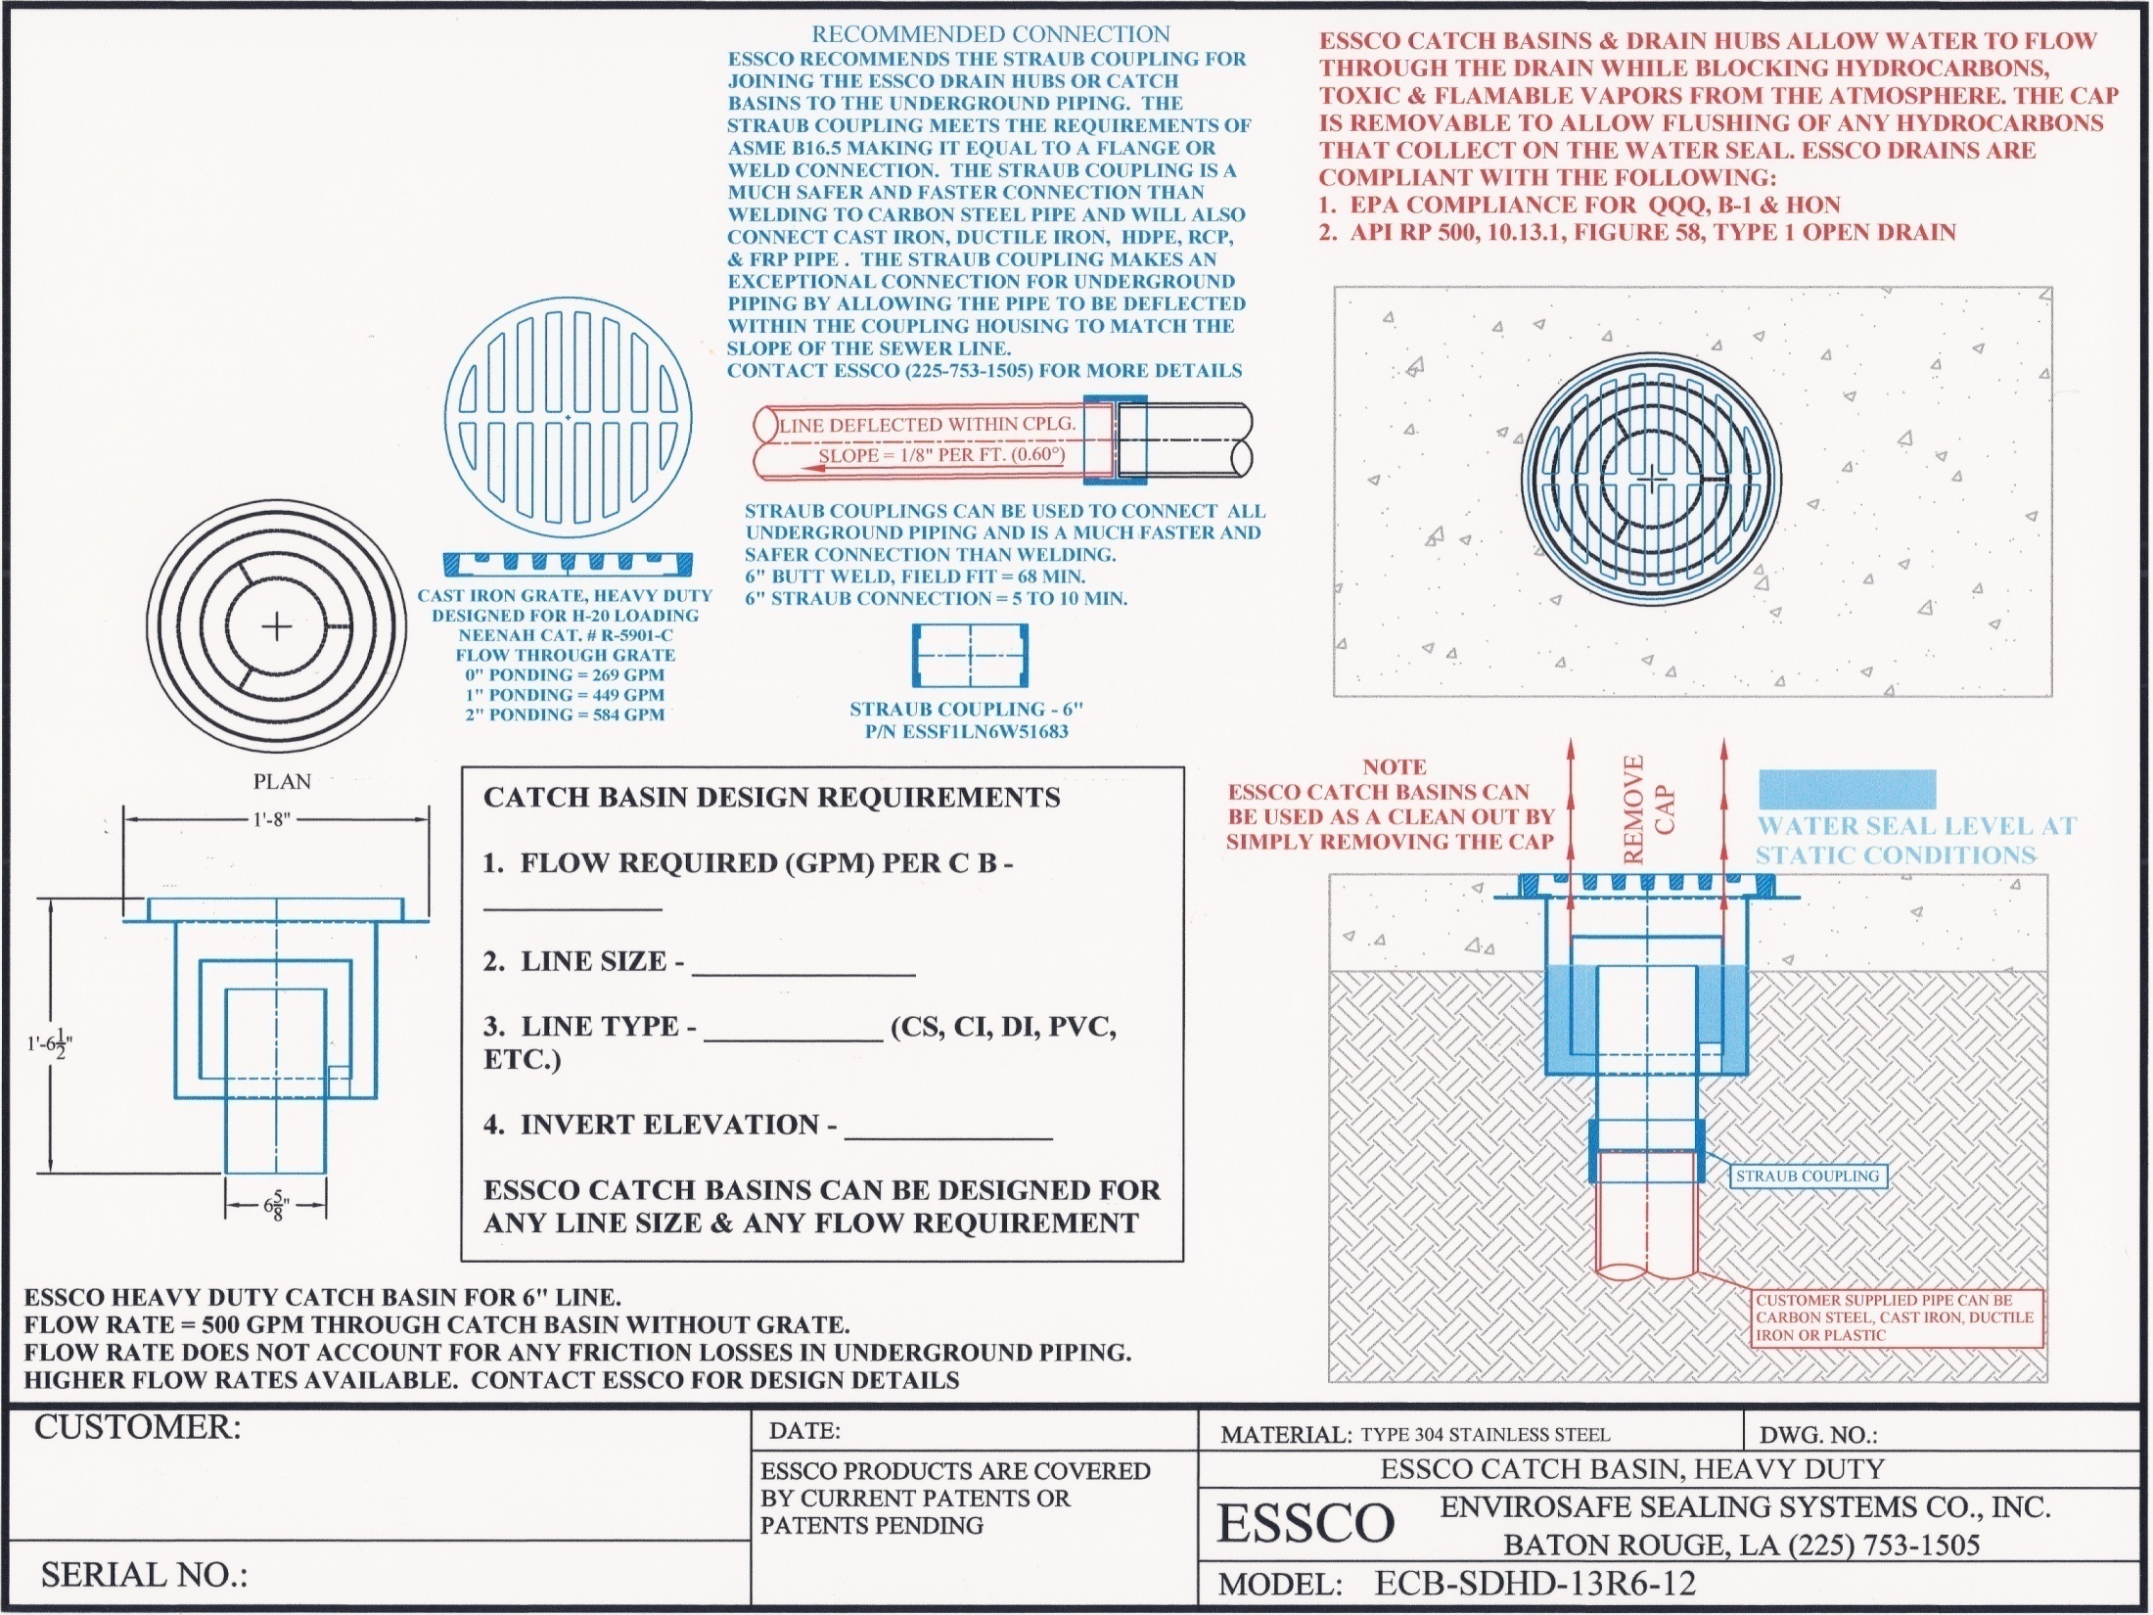

Slide 9
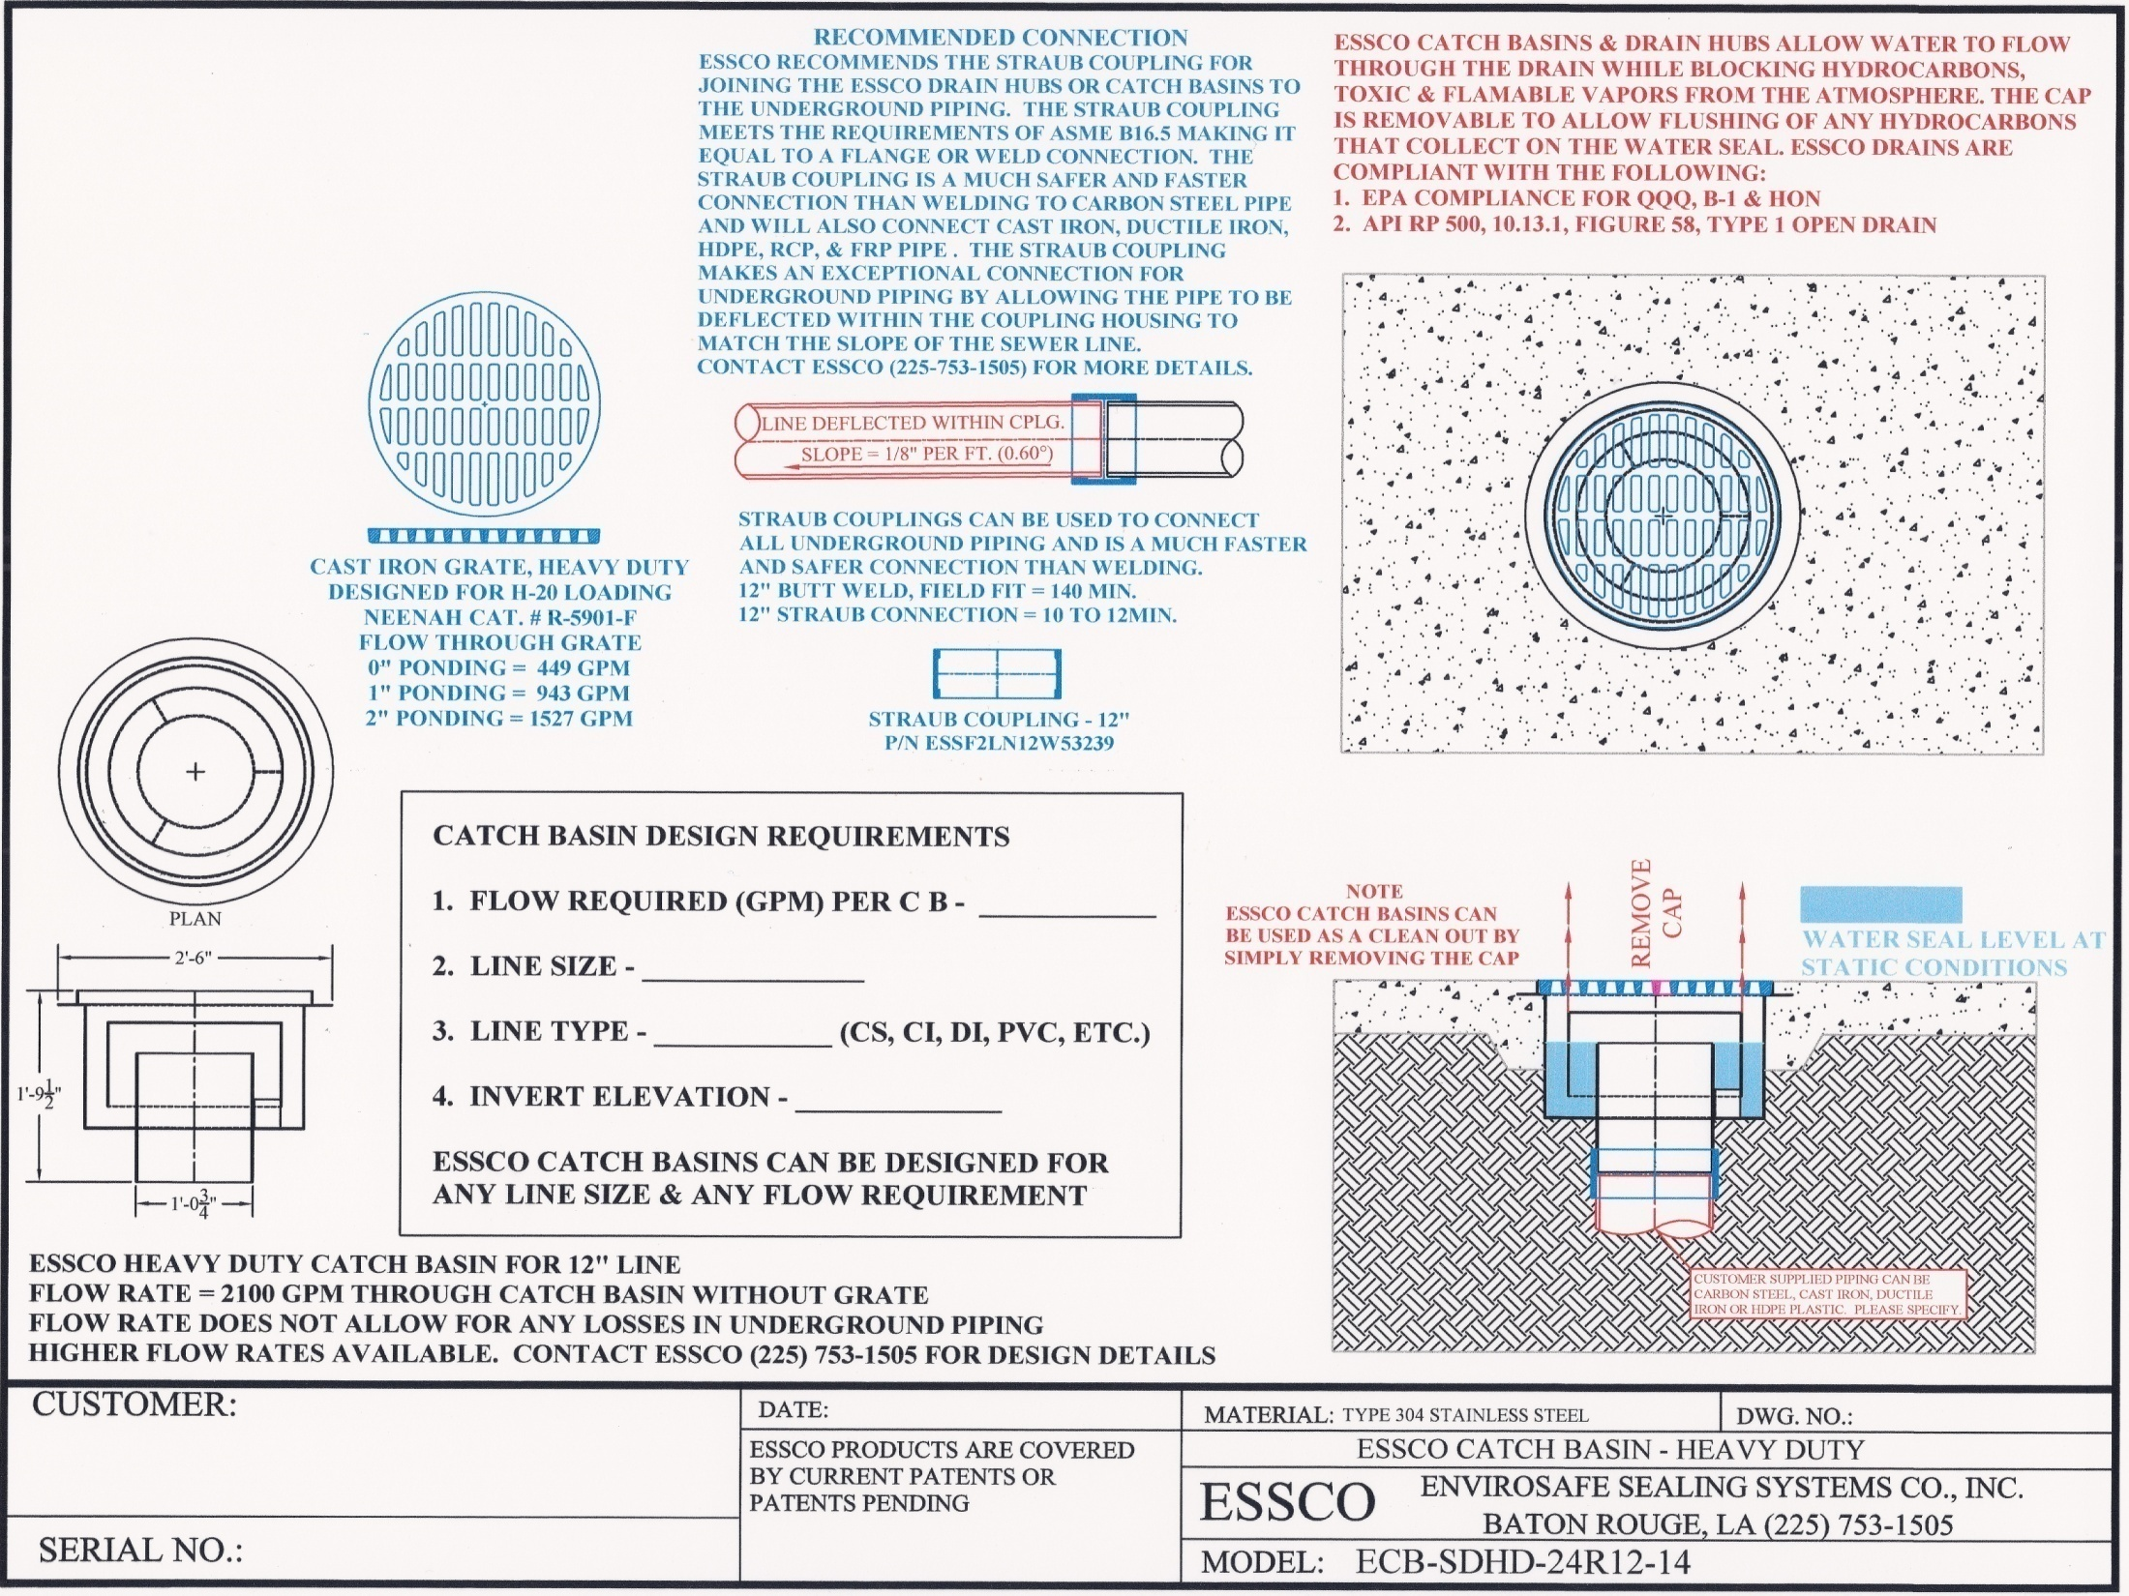

Slide 10
DESIGN NEW SEWER SYSTEMS TO MEET EPA AND STATE COMPLIANCE REGULATIONS FOR QQQ, B-1, HON AND FOR API STANDARD API RP 500 TYPE 1 OPEN DRAIN UTILIZING ESSCO AREA DRAINS

Slide 11
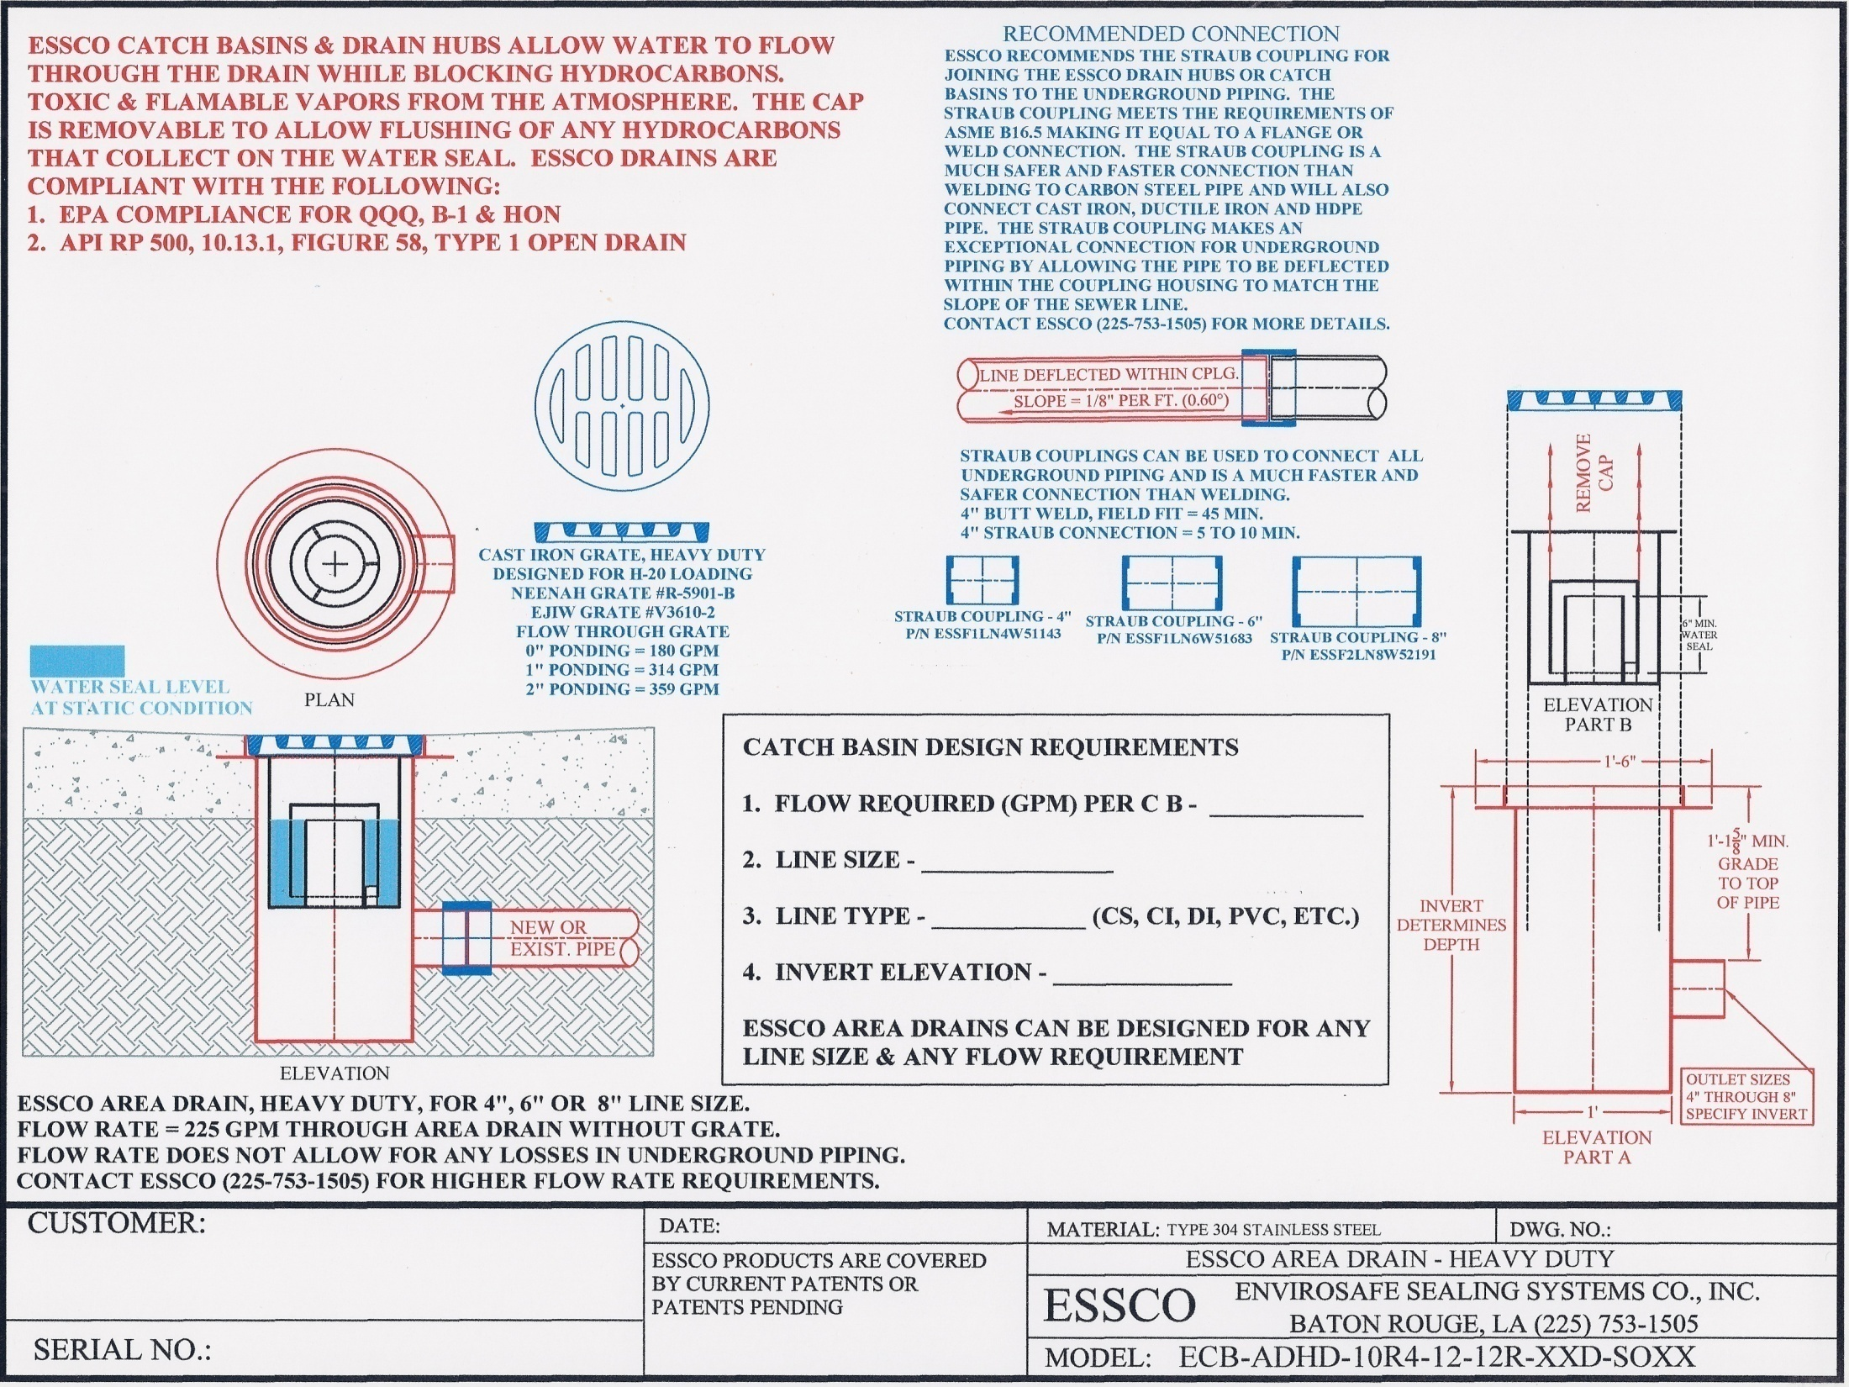

Slide 12
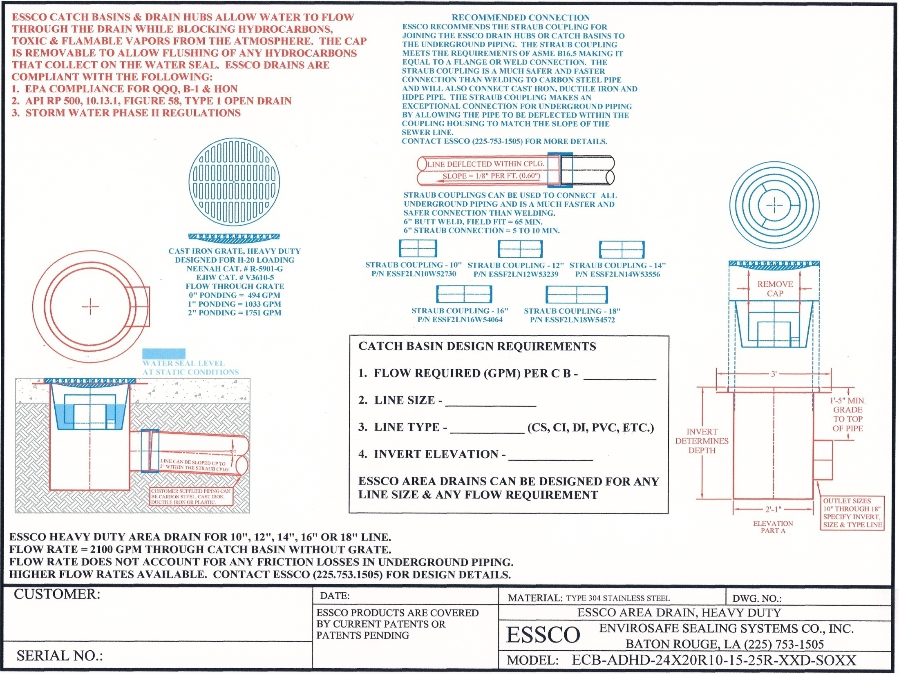

Slide 13
DESIGN ESSCO DRAIN HUBS FOR NEW APPLICATIONS OR REPLACEMENT OF EXISTING OR DAMAGED DRAIN HUBS NOT IN COMPLIANCE WITH EPA REGULATIONS FOR QQQ, B-1, HON AND FOR API STANDARD API RP 500 TYPE 1 OPEN DRAIN

Slide 14
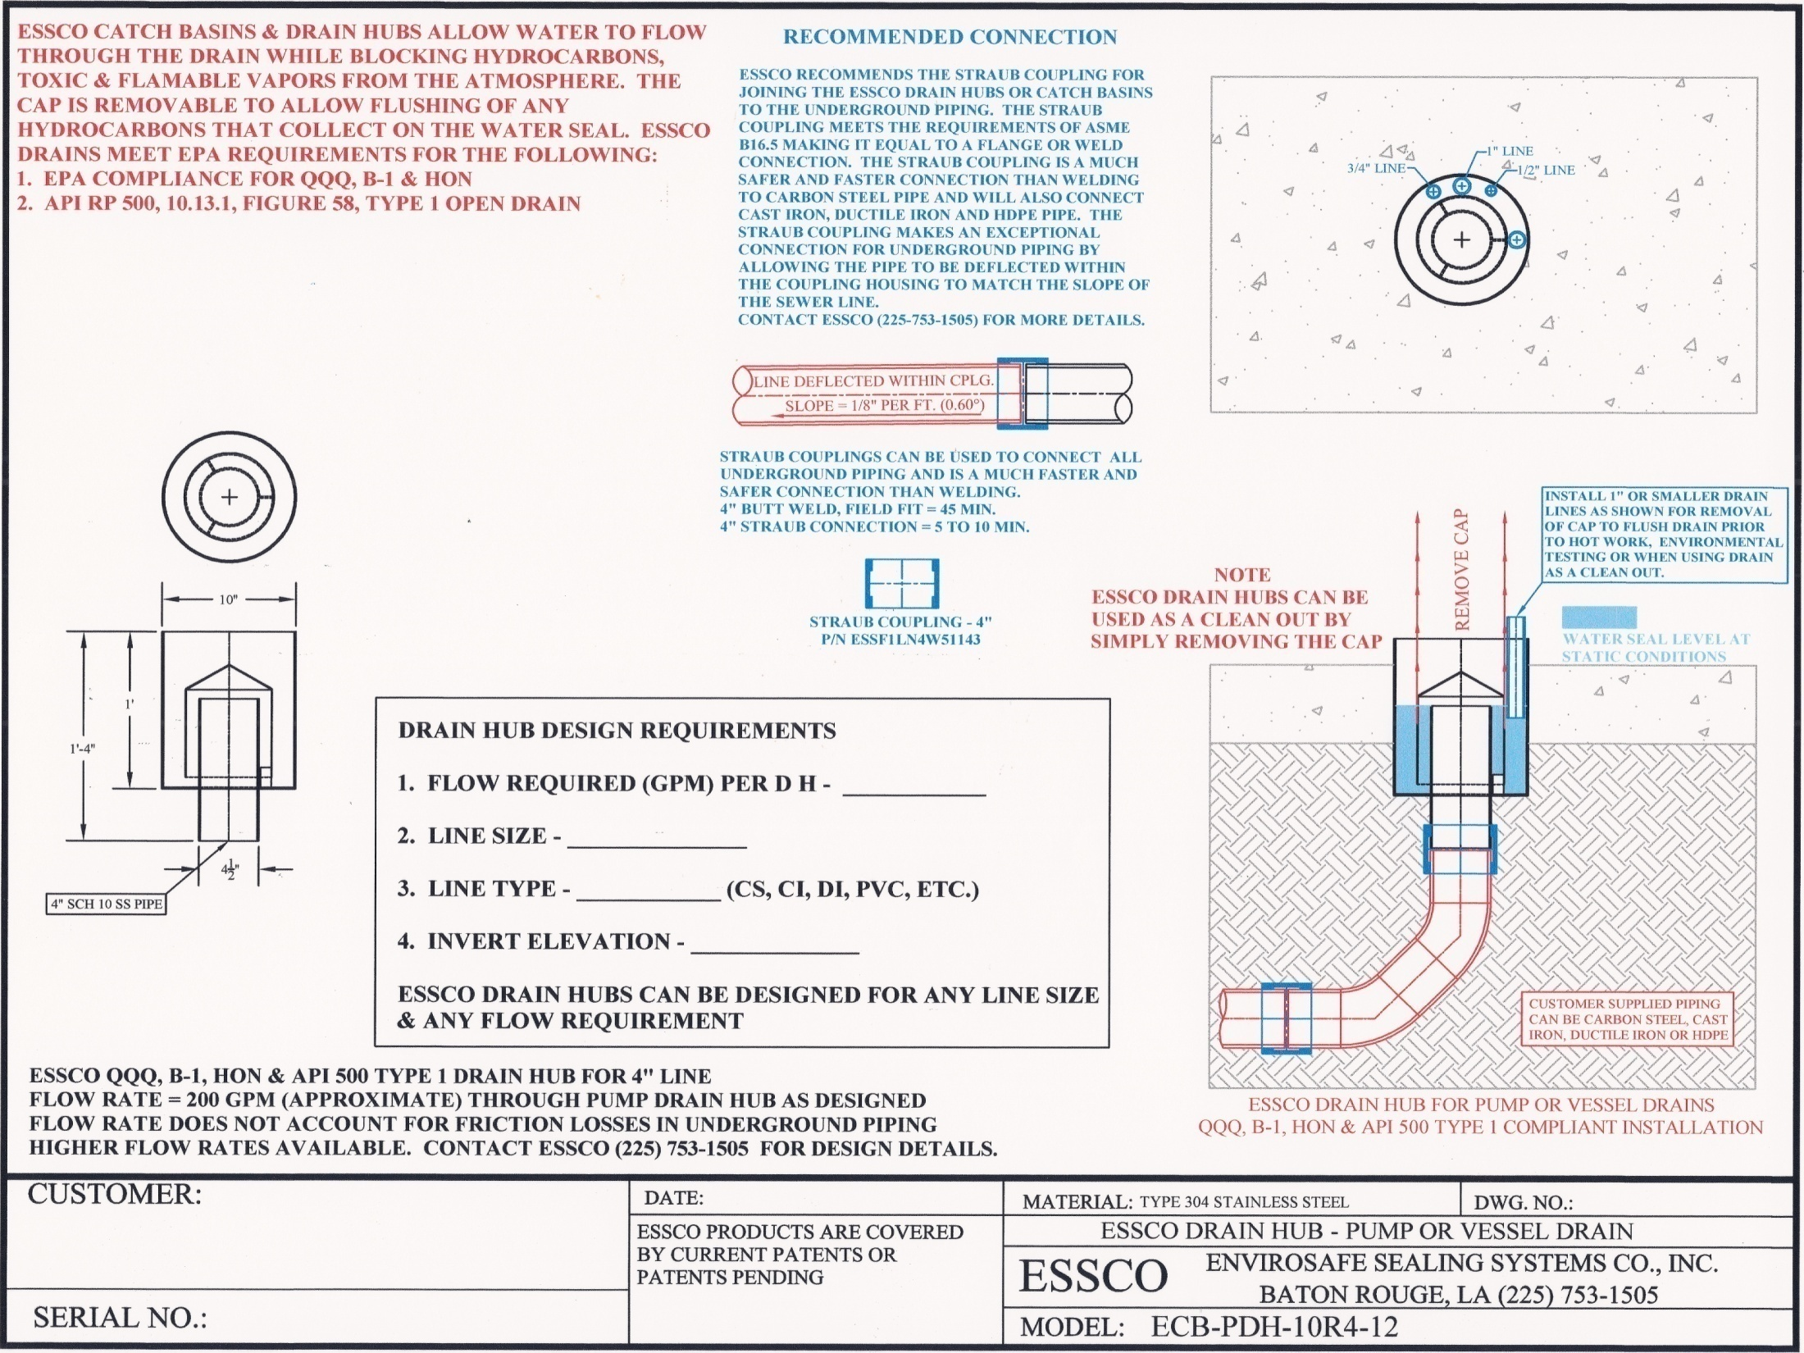

Slide 15
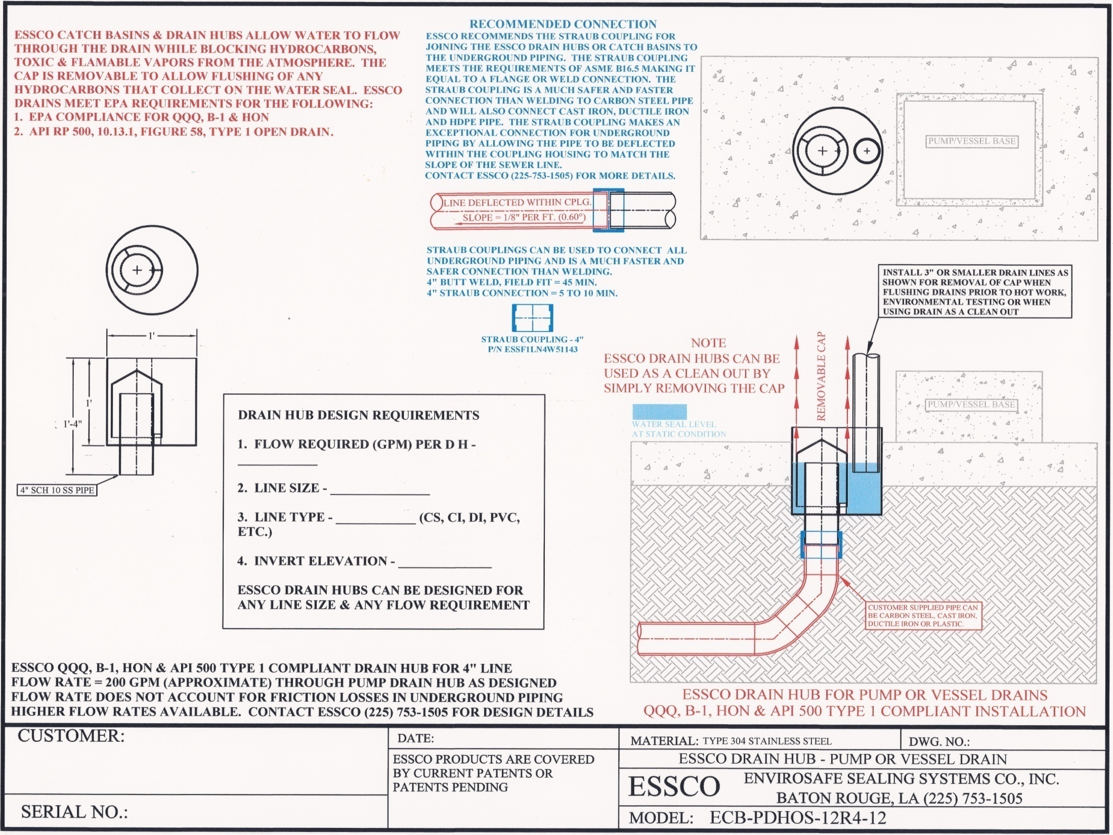

Slide 16
DESIGN NEW SEWER SYSTEMS TO MEET EPA AND STATE COMPLIANCE REGULATIONS FOR QQQ,B-1, HON AND FOR API STANDARD API RP 500 TYPE 1 OPEN DRAIN UTILIZING ESSCO AREA DRAINS AS JUNCTION BOX OR MANHOLE

Slide 17
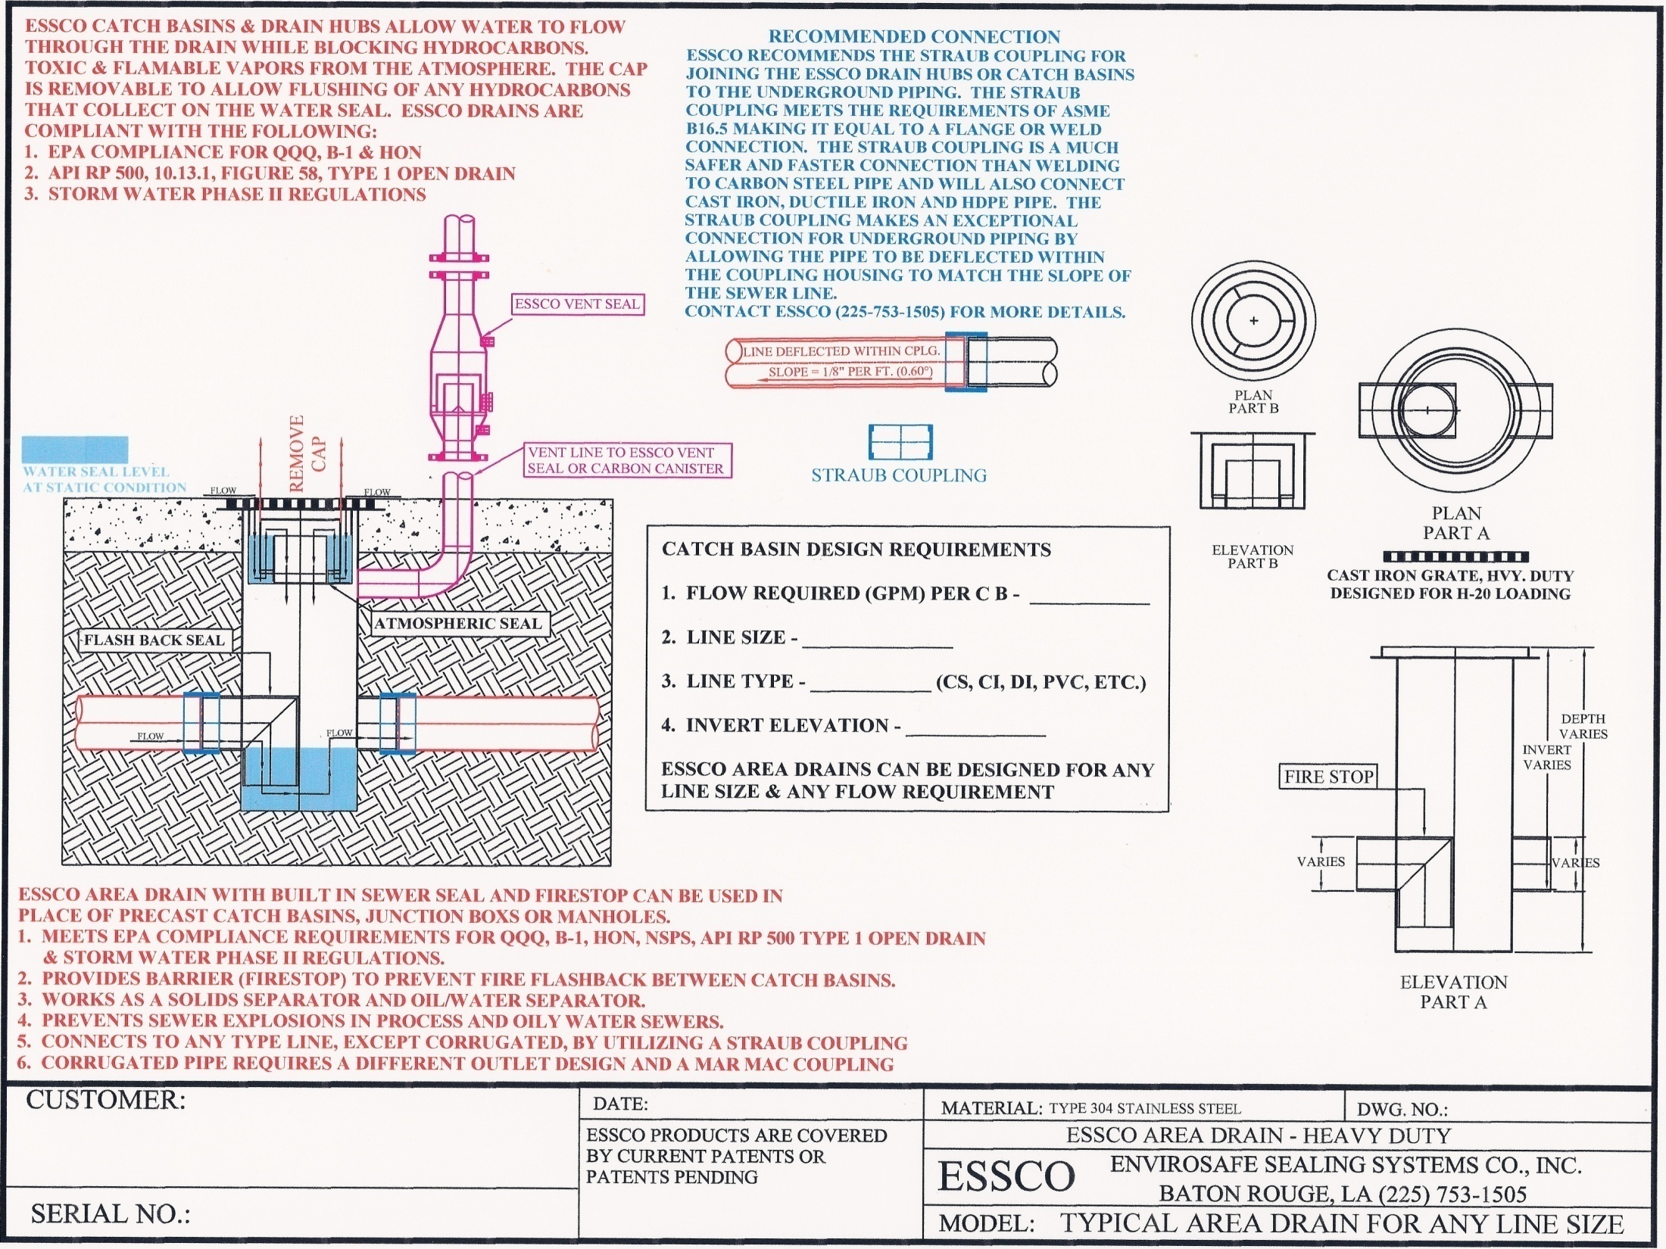

Slide 18
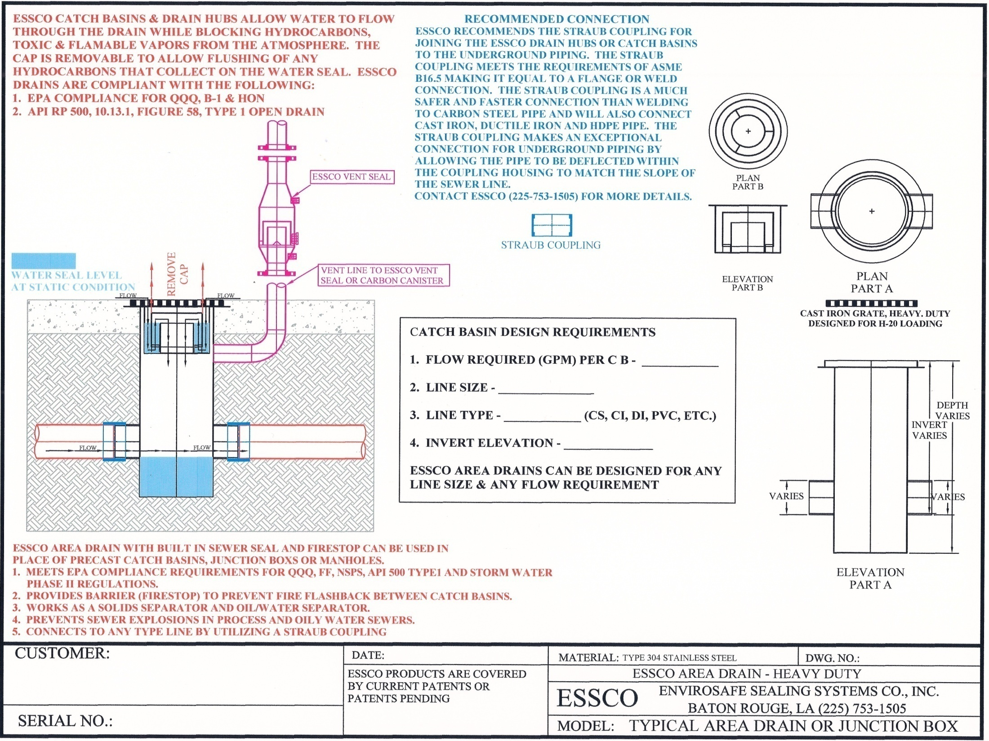

Slide 19
VENTING THE SEWER SYSTEM
SEWER SYSTEMS HAVE ALWAYS BEEN DESIGNED AS OPEN CHANNEL FLOW. EPA REGULATIONS SUCH AS QQQ, B-1 & HON REQUIRING THE SEALING OF SEWER SYSTEMS FROM THE ATMOSPHERE HAVE CHANGED THE SEWER DESIGN TO CLOSED CHANNEL FLOW. CLOSED CHANNEL FLOW DESIGN MAKES VENTING OF THE SEWER SYSTEM MORE CRITICAL TO MAINTAIN FLOW. VENTING NORMALLY OCCURS AT JUNCTION BOXES THROUGH OUT THE SYSTEM BUT ADDITIONAL VENTS MAY NEED TO BE INSTALLED TO MAINTAIN PROPER FLOW. SOME REFINERIES VENT TO A CARBON CANISTER SYSTEM, SOME VENT TO A SCRUBBER AND FLARE SYSTEM AND SOME STILL VENT TO ATMOSPHERE. SEWER SYSTEMS NOT PROPERLY VENTED CAN VAPOR LOCK AND STOP FLOW. THE SEWER SYSTEM MUST BE ABLE TO GET AIR (BREATHE) IN ORDER TO FLOW PROPERLY. A SEALED SEWER SYSTEM CAN PULL A VACUUM AND CAUSE SEALS AT GRADE TO FAIL, LEAVING THE DRAIN OUT OF COMPLIANCE. ESSCO HAS DEVELOPED A VENT SEAL SYSTEM THAT ALLOWS THE SEWER SYSTEM TO BREATHE DURING NORMAL OPERATING CONDITIONS WHILE NOT EMITTING VOC’S TO THE ATMOSHPERE.

Slide 20
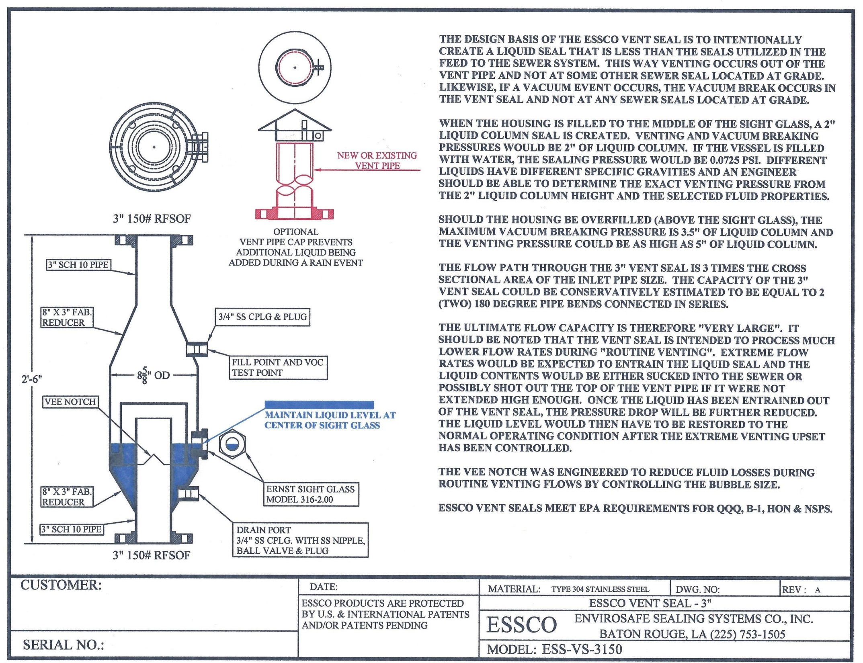

Slide 21
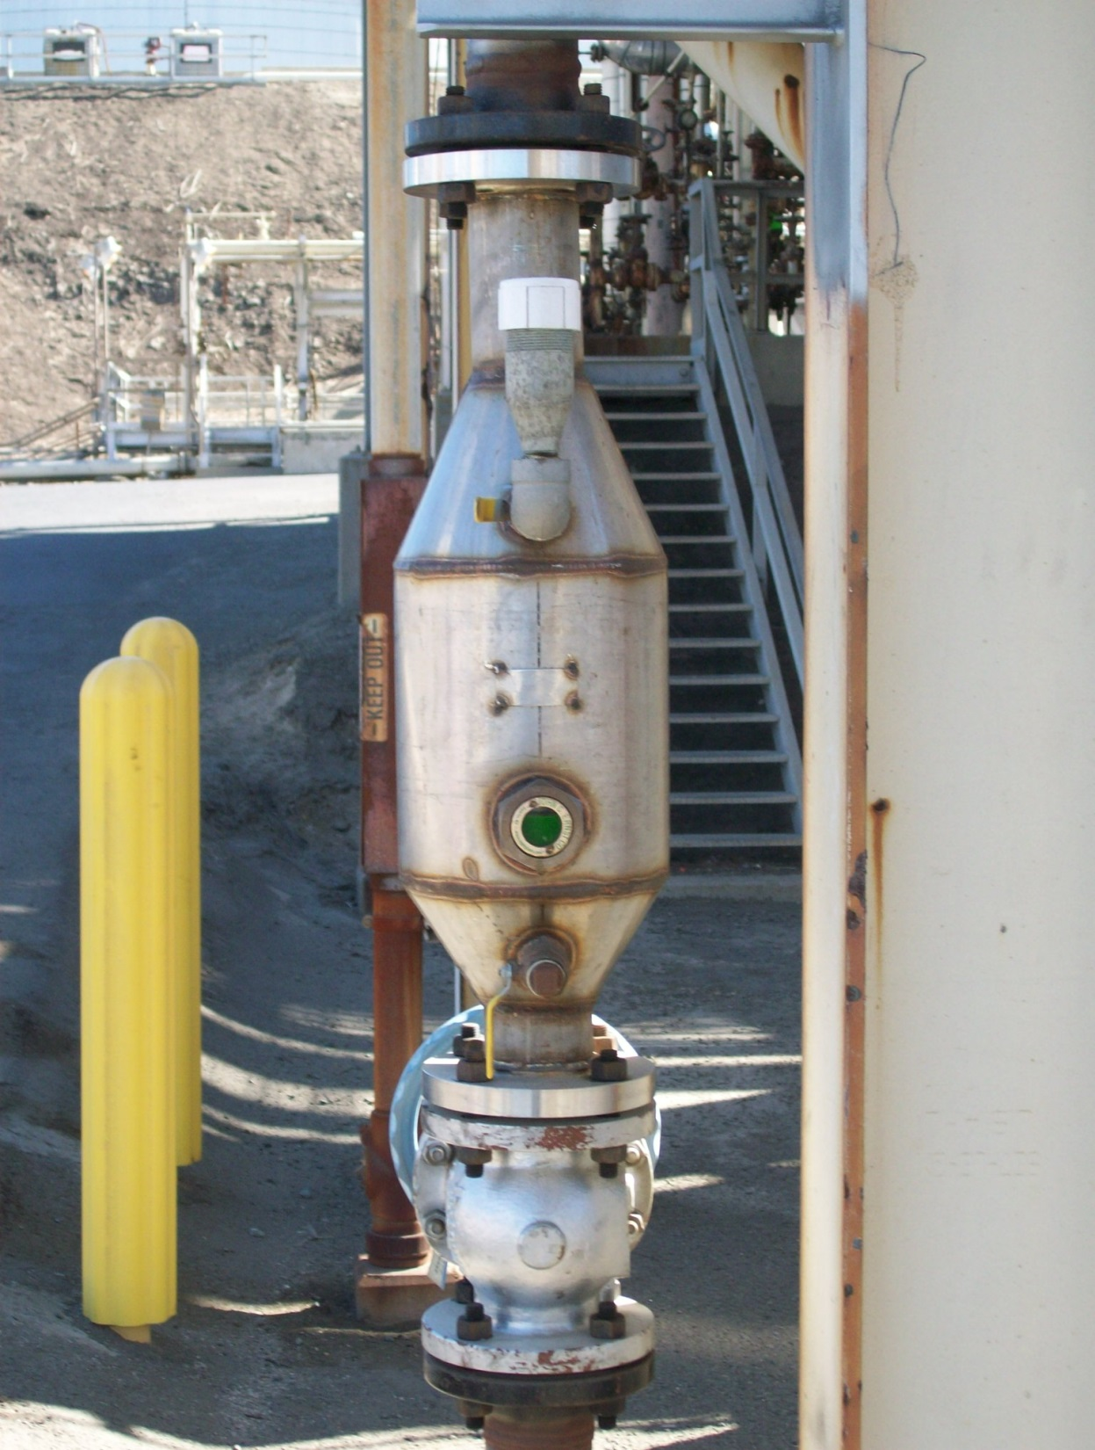
ESSCO VENT SEAL

Slide 22
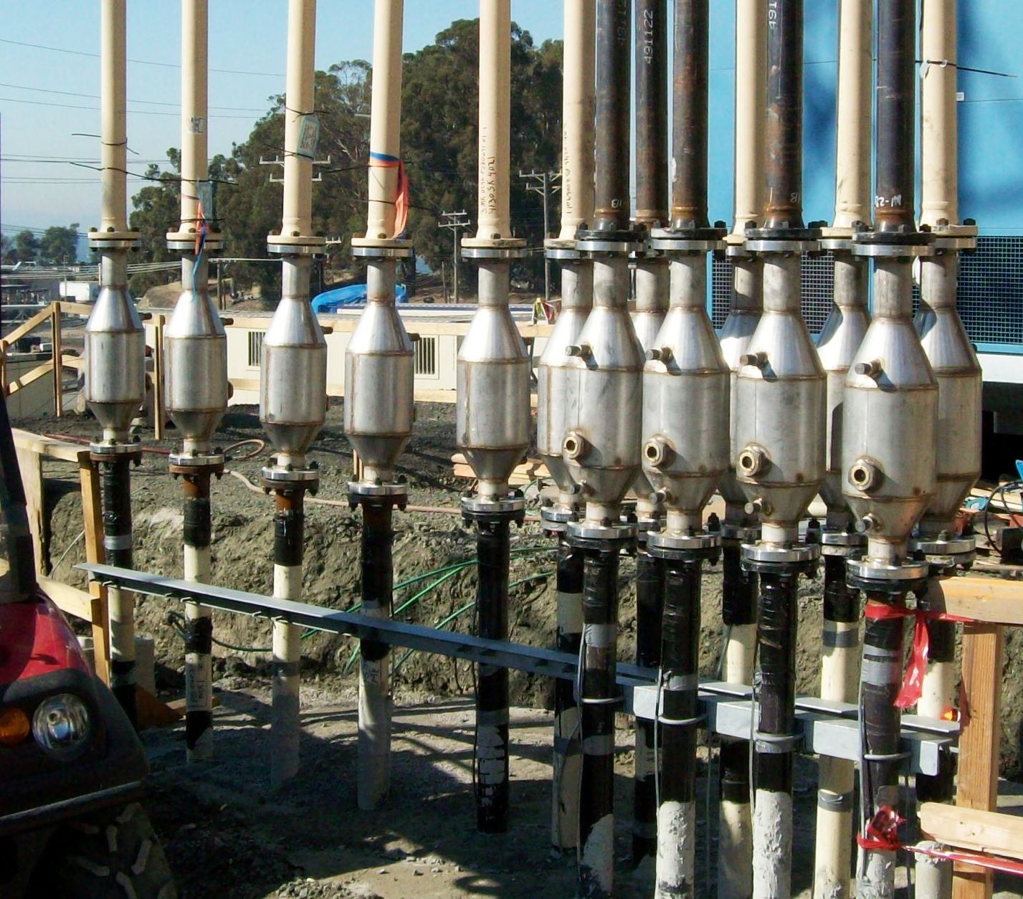

Slide 23
PLUGGED SEWER LINES
PLUGGED SEWER LINES ARE A MAJOR PROBLEM FOR REFINING AND CHEMICAL PLANTS AS WELL AS MUNICIPAL SEWER SYSTEMS. PLUGGED SEWER LINES CAUSE FLOODING PROBLEMS AND CAN PREVENT VOC’S FROM MOVING THROUGH THE SYSTEM PROPERLY SO THEY CAN BE VENTED. SAND, DIRT, GRAVEL AND OTHER DEBRIS GETS INTO THE SYSTEM AND SETTLES OUT AS IT MIGRATES THROUGH THE SYSTEM AND BECOMES HAZARDOUS SLUDGE THAT REQUIRES COSTLY DISPOSAL.

Slide 24
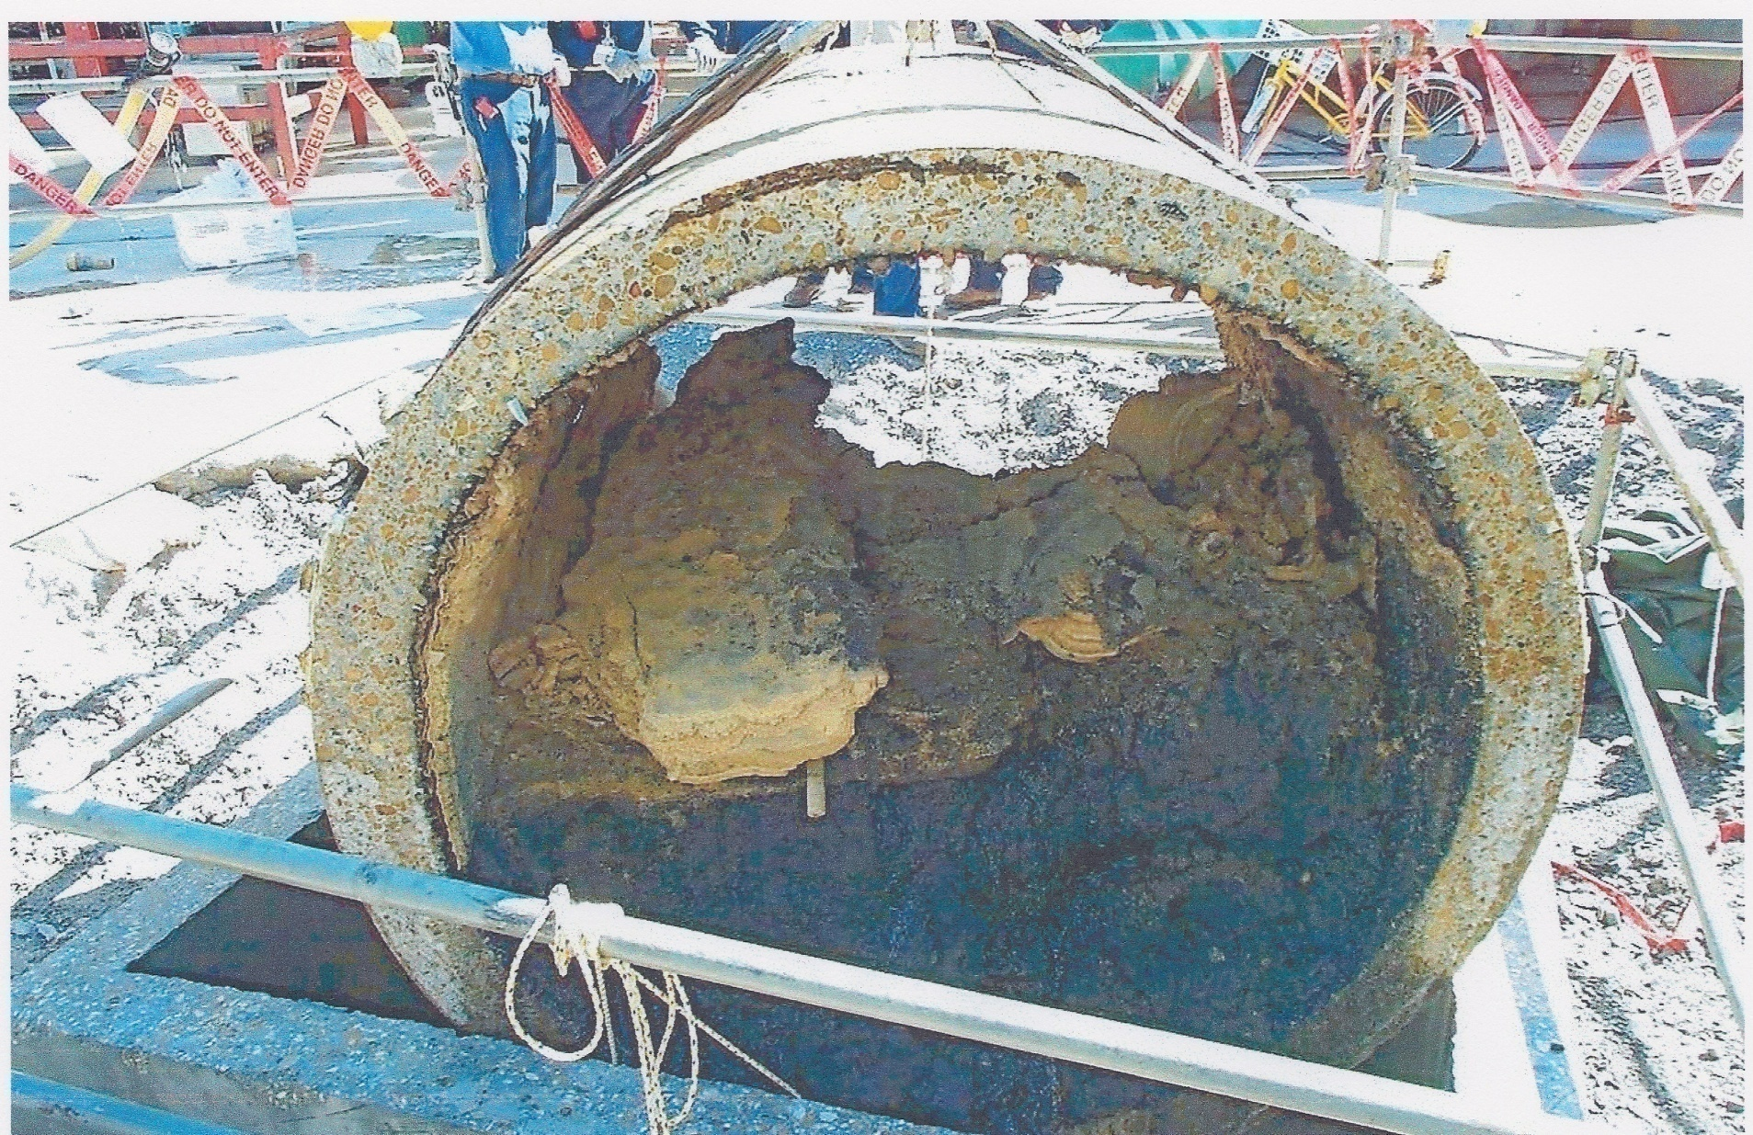
PHOTO OF 60” REINFORCED CONCRETE PIPE THAT HAD TO BE REMOVED TO FIND OUT WHY FLOW CAPACITY HAD BEEN GREATLY REDUCED. NEW MANHOLE HAD TO BE INSTALLED TO FACILITATE REMOVAL OF THIS SECTION OF LINE AND CLEANING REMAINDER OF LINE. ESSCO CATCH BASINS ARE DESIGNED TO PREVENT SOLIDS FROM GETTING INTO THE UNDERGROUND SEWER SYSTEM.

Slide 25
ESSCO CATCH BASIN WITH FILTRATION SYSTEM
ESSCO CATCH BASINS WITH FILTRATION MEETS EPA REQUIREMENTS FOR QQQ, B-1, HON & STORM WATER PHASE II REGULATIONS. ESSCO CATCH BASINS WITH FILTRATION SYSTEM ARE DESIGNED WITH TWO CHAMBERS TO SEPARATE DEBRIS (SAND, DIRT, ROCKS, ETC.) AND PREVENTS PARTICLES AS SMALL AS 150 MICRONS FROM GETTING INTO THE UNDERGROUND SEWER SYSTEM CAUSING REDUCED FLOW AND EVENTUALLY PLUGGING. THE FIRST CHAMBER WORKS LIKES A SOLID OR OIL/WATER SEPARATOR AND REMOVES THE MAJORITY OF DEBRIS THAT WASHES INTO THE CATCH BASIN DURING A RAIN OR WASH DOWN. ANY PARTICLES THAT REMAIN IN SUSPENSION DURING FLOW AND ENTER THE SECOND CHAMBER WILL BE RETAINED IN THE PROPRIETARY FILTER POUCH IN CHAMBER TWO. WATER ONLY WILL FLOW THROUGH THE PROPRIETARY FILTER POUCH. THE PROPRIETARY FILTER POUCH CAN BE EASILY REMOVED AND REPLACED. CONTACT ESSCO AT 225-753-1505 WITH ANY QUESTIONS CONCERNING THE ESSCO FILTRATION SYSTEM OR TO DISCUSS THE BENEFITS OF ESSCO CATCH BASINS VERSUS PRECAST CONCRETE CATCH BASINS

Slide 26
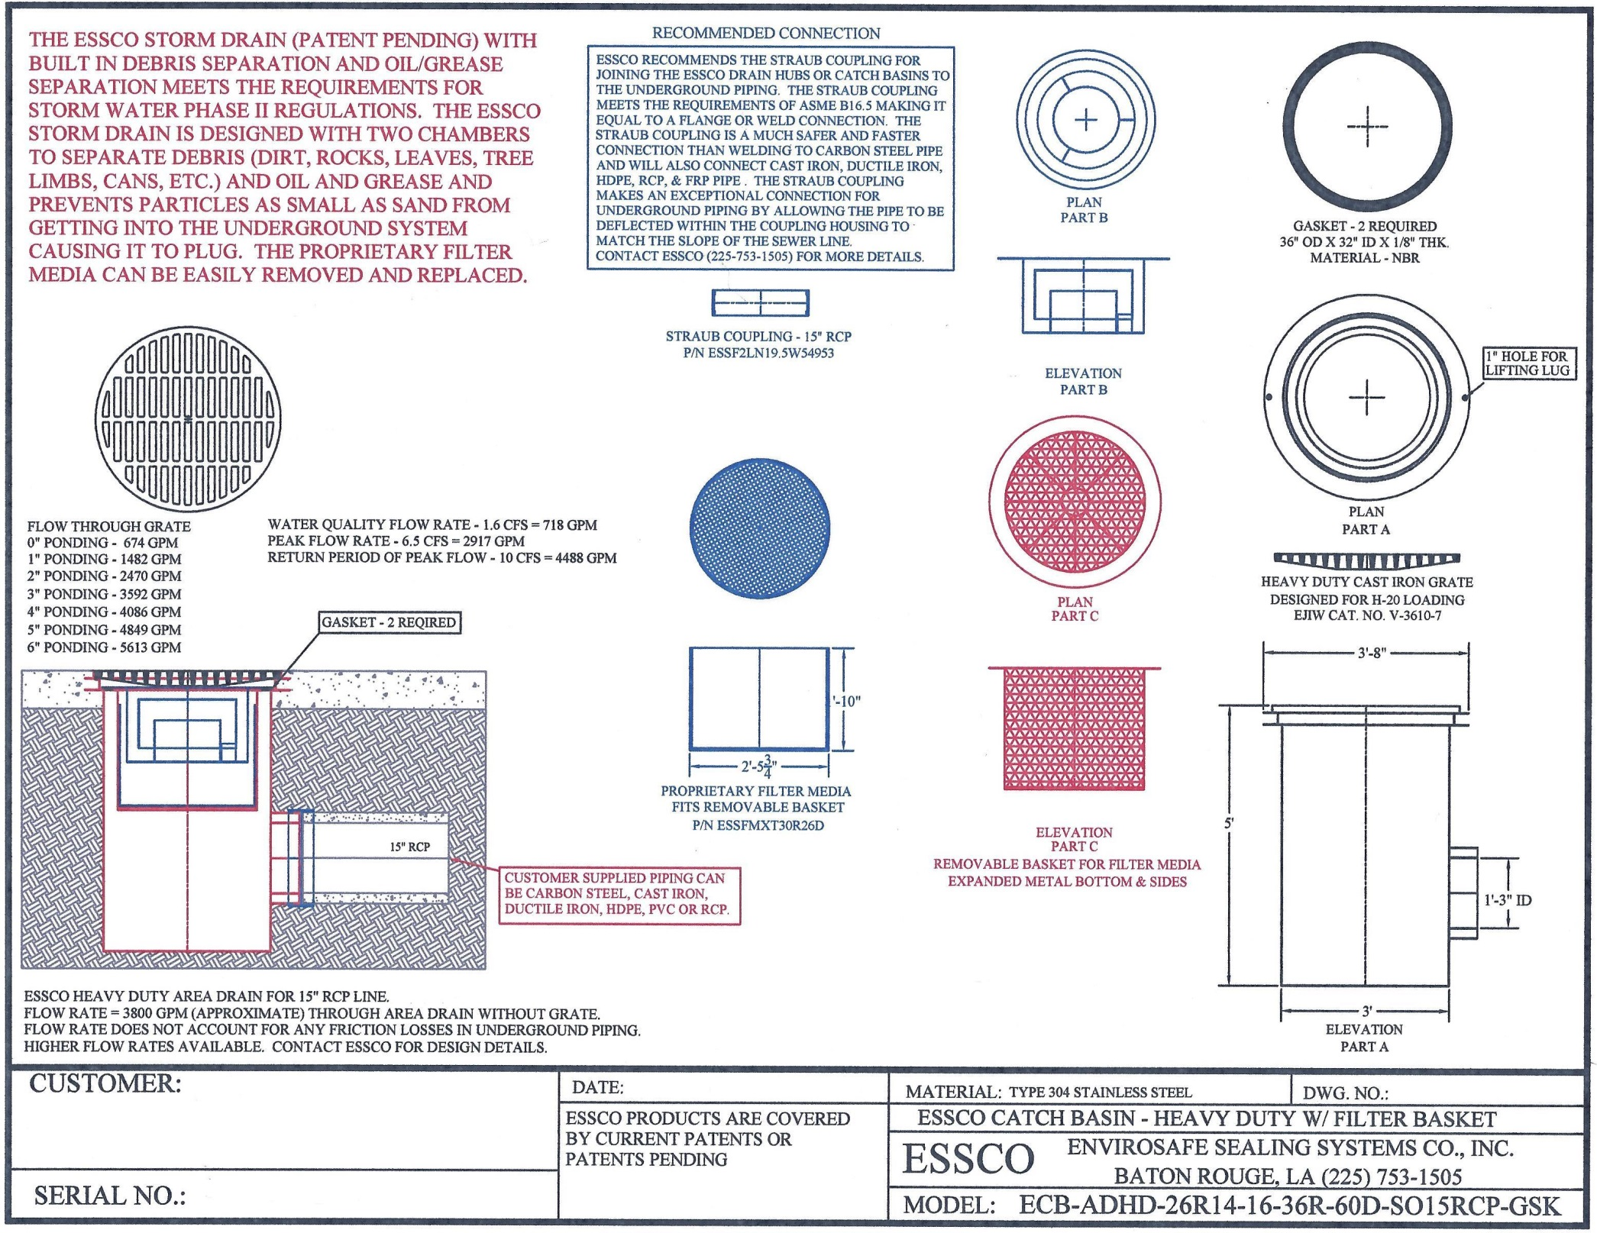

Slide 27
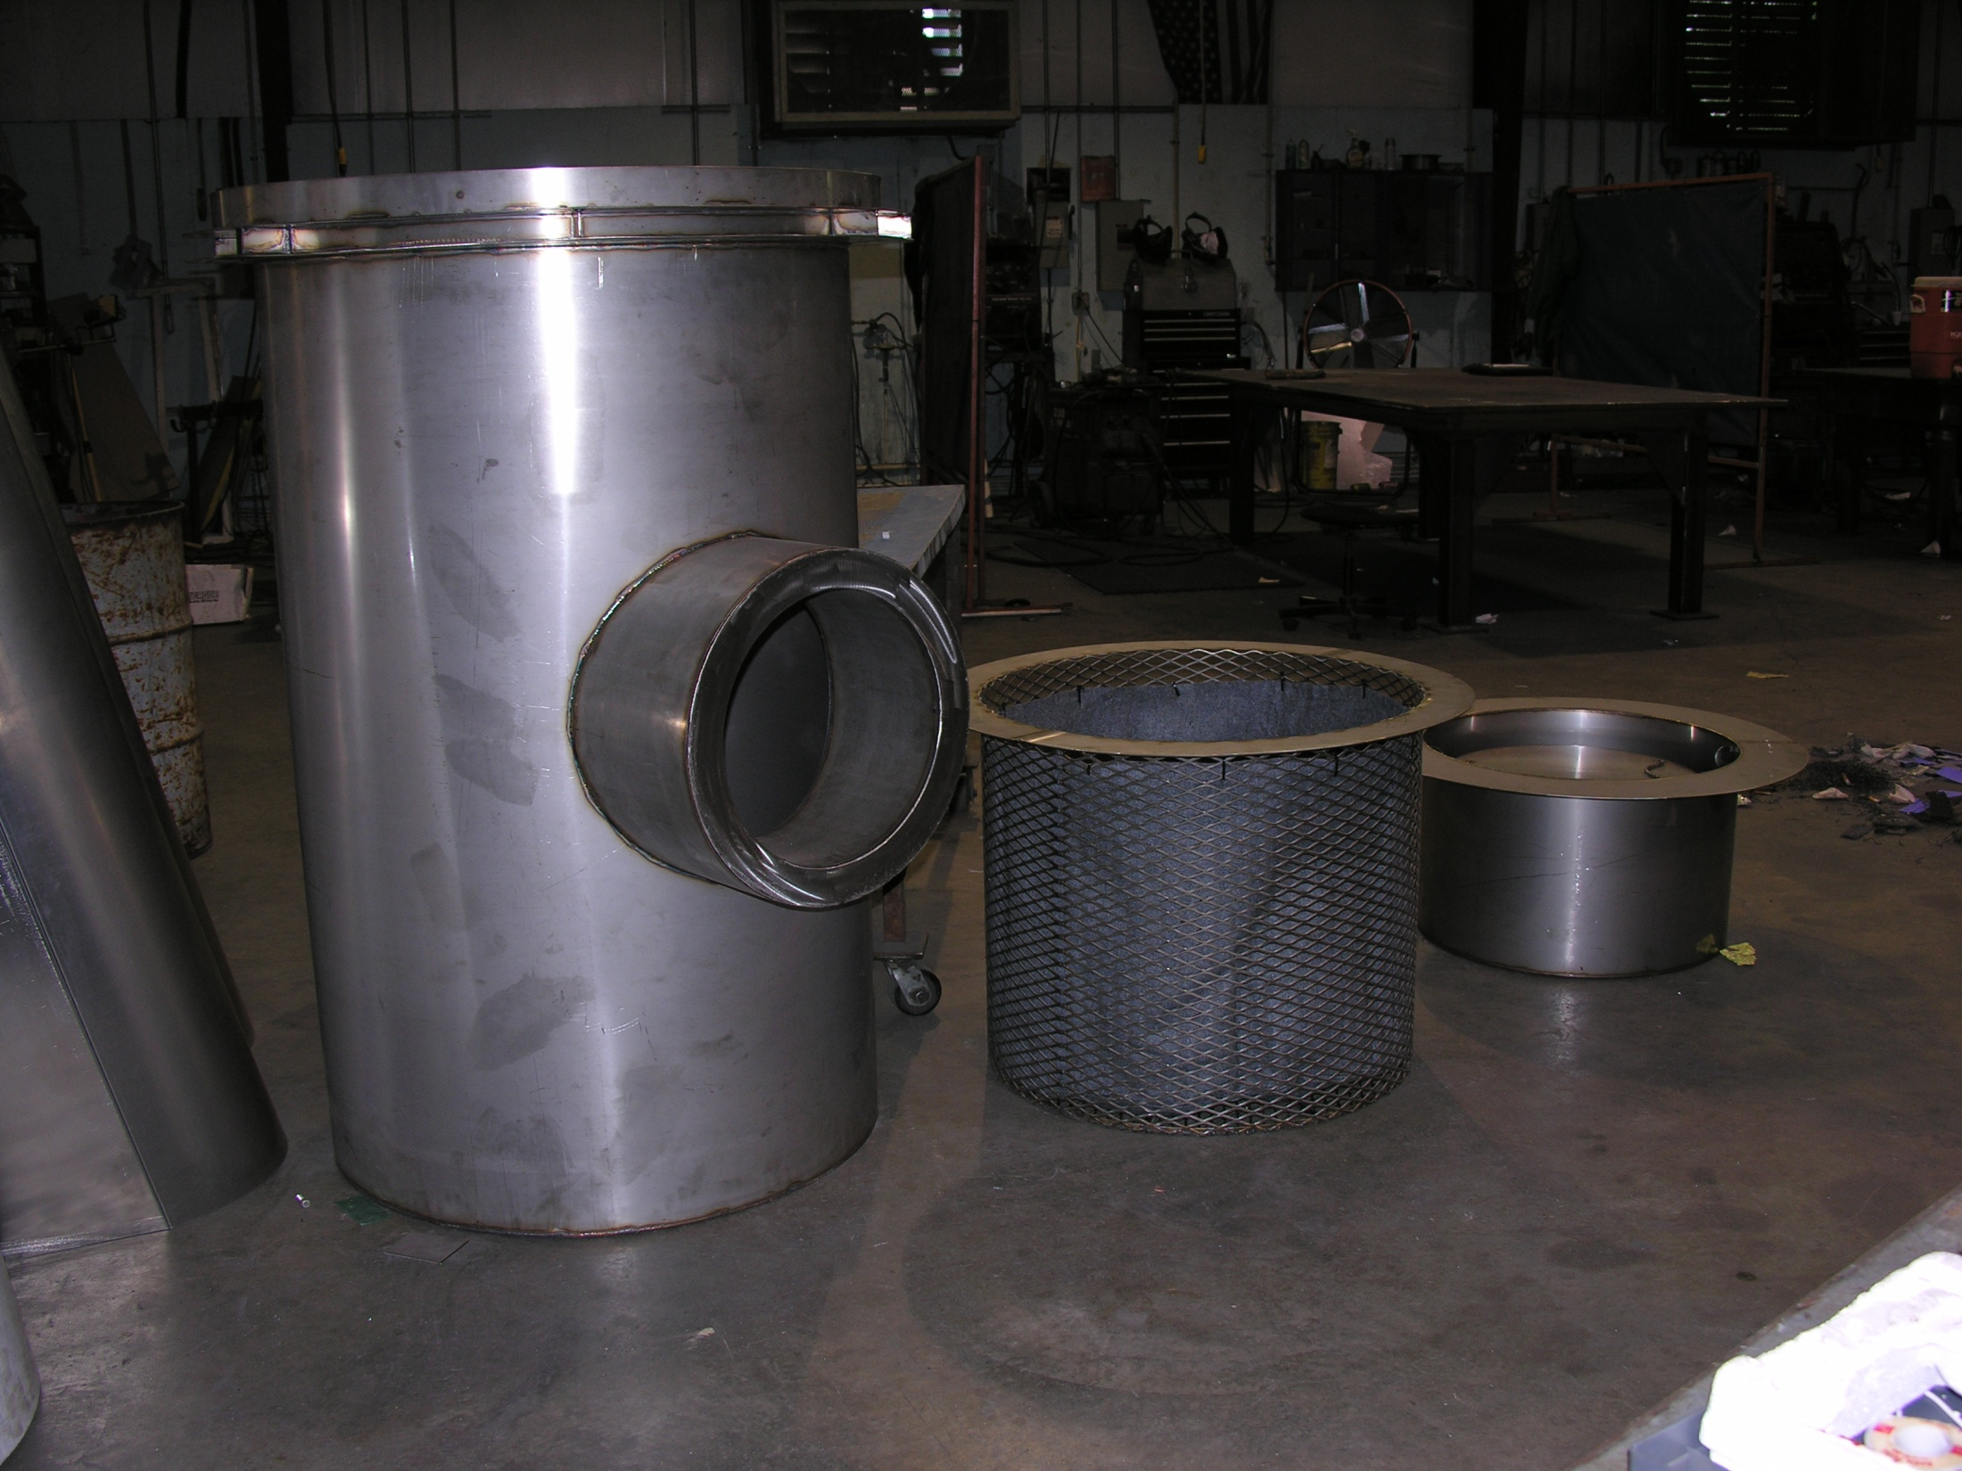
UPPER CHAMBER
LOWER CHAMBER
BASE UNIT
PATENT PENDING

Slide 28
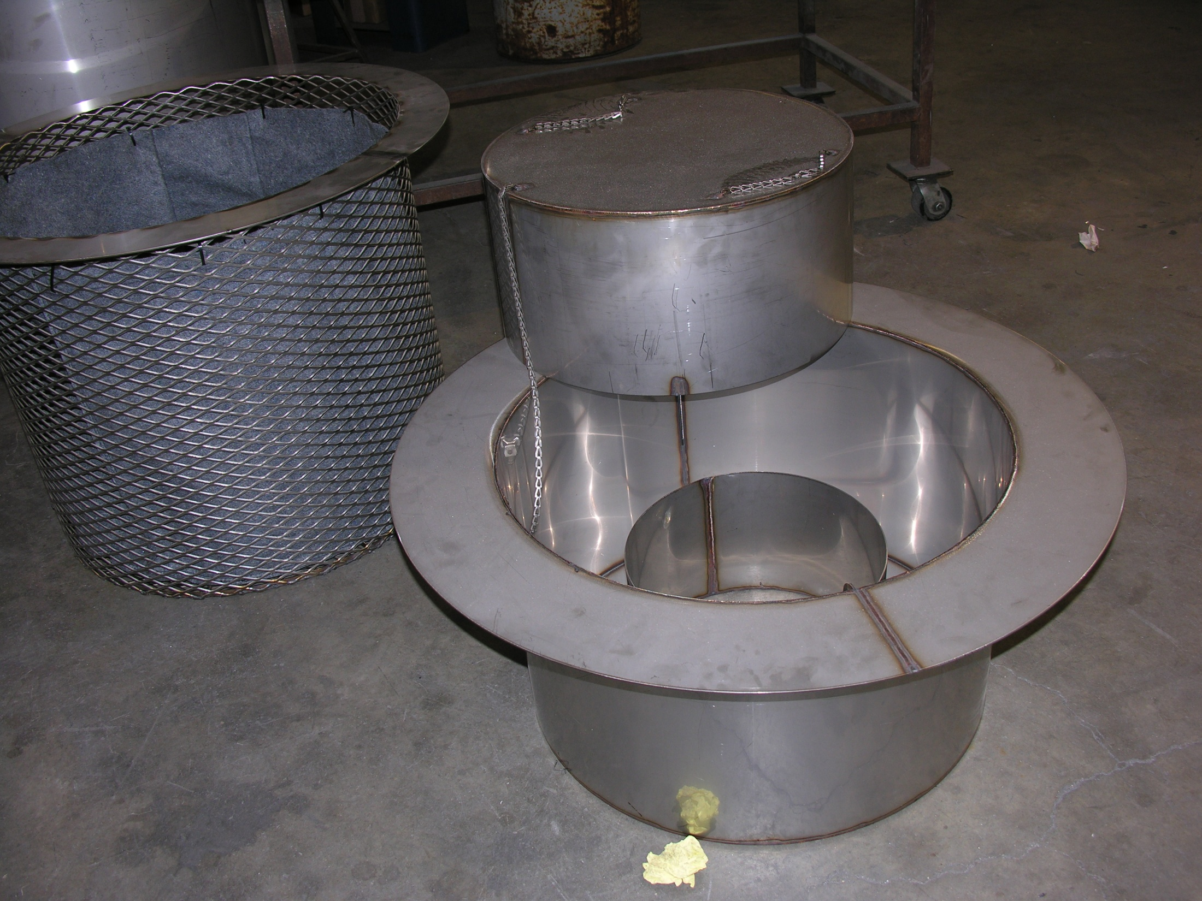

Slide 29
EPA COMPLIANCE FOR QQQ, B-1, HON & NSPS
STORM WATER PHASE II REGULATIONS
API RP 500 TYPE 1 OPEN DRAIN
CATCH BASINS, DRAIN HUBS, SEWER SEALS & MANHOLES FOR REFINING, PETROCHEMICAL,
GAS PROCESSING, PULP & PAPER AND MUNICIPAL STORM WATER APPLICATIONS
P.O. BOX 77077
BATON ROUGE, LA 70879
(225) 753-1505
E-MAIL: Info@sewerseals.com
WEB: www.sewerseals.com
ESSCO CATCH BASINS CAN BE DESIGNED FOR
ANY FLOW RATE & ANY SIZE OR TYPE LINE
ESSCO PRODUCTS ARE PROTECTED BY US &
INTERNATIONAL PATENTS AND/OR PATENTS PENDING

